Slide 1
Introduction to Analytics
Lecture 2

Slide 2
Output: Knowledge Representation

Slide 3
Representing Structural Patterns
Many different ways of representing patterns
Decision trees, rules, instance-based, …
Also called “knowledge” representation
Representation determines inference method
Understanding the output is the key to understanding the underlying learning methods
Different types of output for different learning problems (e.g., classification, regression, …)

Slide 4
Decision Tables
Most rudimentary form of representing output: use the same format as the input!!
Decision table for play-time of sports game
Main problem: selecting the right attributes
Outlook | Temperature | Humidity | Windy | Play-time
Sunny | 85 | 85 | False | 5
Sunny | 80 | 90 | True | 0
… | … | … | … | …
Notes:
Can you give an example in everyday (student) life of a decision table? (Hint: think of registration. Another example: a LinkedIn headhunter/recruiter. Another example: buying a car.)

Slide 5
Decision Trees
“Divide-and-conquer” approach produces tree
Nodes involve testing a particular attribute
Usually, attribute value is compared to constant
Other possibilities
Comparing values of two attributes
Using a function of one or more attributes
Leaves of the tree assign classification, set of classifications, or probability distribution of instances
Instance with unknown class is routed down the tree and assigned the class of the node where it ends up
Notes:
Let’s use the example of a police officer giving a ticket to study these concepts.

Slide 6
Nominal and Numeric Attributes
Nominal attribute: number of children usually equal to number of values ➔ attribute won’t get tested more than once
Other possibility: division into two subsets
Numeric attribute: test whether value is greater or less than constant ➔ attribute may get tested several times
Other possibility: three-way split (or multi-way)
Integer: less than, equal to, greater than
Real: below, within, above (intervals)
Notes:
Look at previous tree examples ( buying a car, LinkedIn, etc)

Slide 7
Missing Attribute Values
Does absence of value have some significance?
Yes ➔ “missing” is a separate value
No ➔ “missing” must be treated specially
Solution A: assign instance to most popular branch
Solution B: ‘duplicate’ instance and send down multiple paths
Duplicates receive weight according to fraction of training instances that go down each branch
Classifications from leaf nodes are combined using the weights that have percolated to them
Notes:
If an officer pulls someone over and their license is missing, should this be a category by itself with its own attribute value (e.g., ‘missing’)?
How about in an accident, when the passengers in the back seat don’t recall whether they had seatbelts on or not?

Slide 8
Classification Rules
Popular alternative to decision trees
Antecedent (pre-condition): a series of tests (just like the tests at the nodes of a decision tree)
Test are usually logically ANDed together (but may also be general logical expressions)
Consequent (conclusion): classes, set of classes, or probability distribution assigned by rule
Individual rules are often logically ORed together
Conflicts arise if different conclusions apply
Can you come up with an example of this based on our running example about receiving tickets?
Notes:
Can you come up with an example of this based on our running example about receiving tickets?
E.g., give a warning or give a ticket to first-time offenders?

Slide 9
From trees to rules
Easy: converting a tree into a set of rules
One rule for each leaf:
Antecedent contains a condition for every node on the path from the root to the leaf
Consequent is class assigned by the leaf
Produces rules that are unambiguous
Doesn’t matter in which order they are executed
But: resulting rules are unnecessarily complex
Pruning to remove redundant tests/rules (What does this mean in terms of our ‘running example’?)
Notes:
Pruning to remove redundant tests/rules (What does this mean in terms of our ‘running example’?)
Hint: look at the condition at the root node – how many times does it appear in the rules generated from the tree?

Slide 10
From rules to trees
More difficult: transforming a rule set into a tree
Tree cannot easily express disjunction between rules
Example: rules which test different attributes
Symmetry needs to be broken
Try rewriting this ‘code’ with one variable per test
Corresponding tree contains identical subtrees (⇒ “replicated subtree problem”)
If a and b then x If c and d then x
Notes:
Class exercise: get into small groups and try to build a tree from these rules… it’s like being forced to build an if-else control structure that must begin with just a single test – e.g., “if (a) …”, and all subsequent tests likewise can test only one ‘variable’.

Slide 11
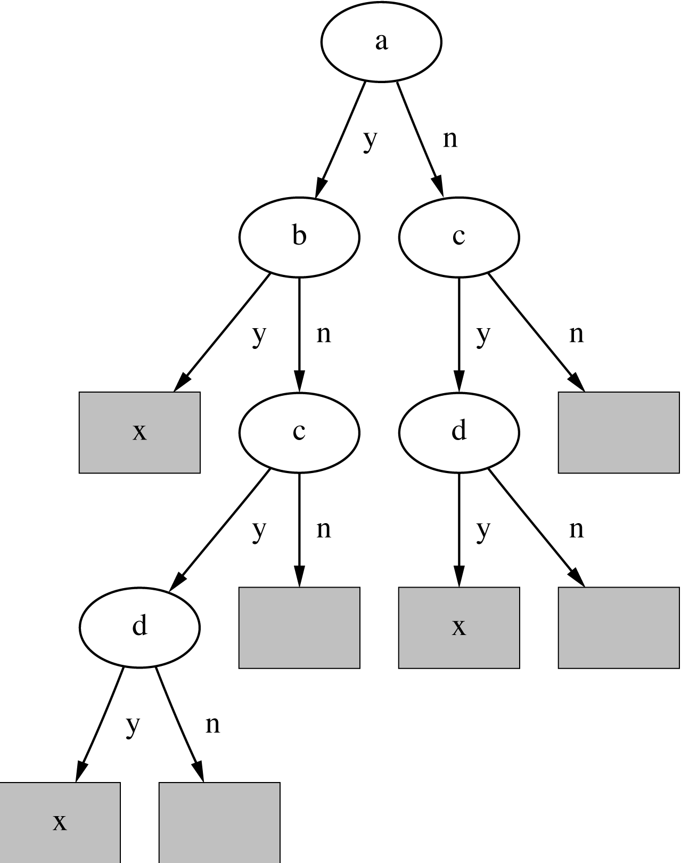
A tree for a simple disjunction
Notes:
The ‘code’ would look something like this:
if a
if b
x
else if c
if d
x
fi
fi
fiesle
else if c
if d
x
fi
fi
fiesle

Slide 12
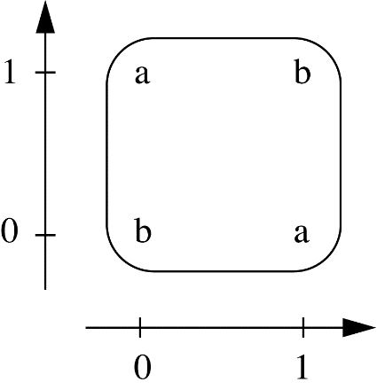
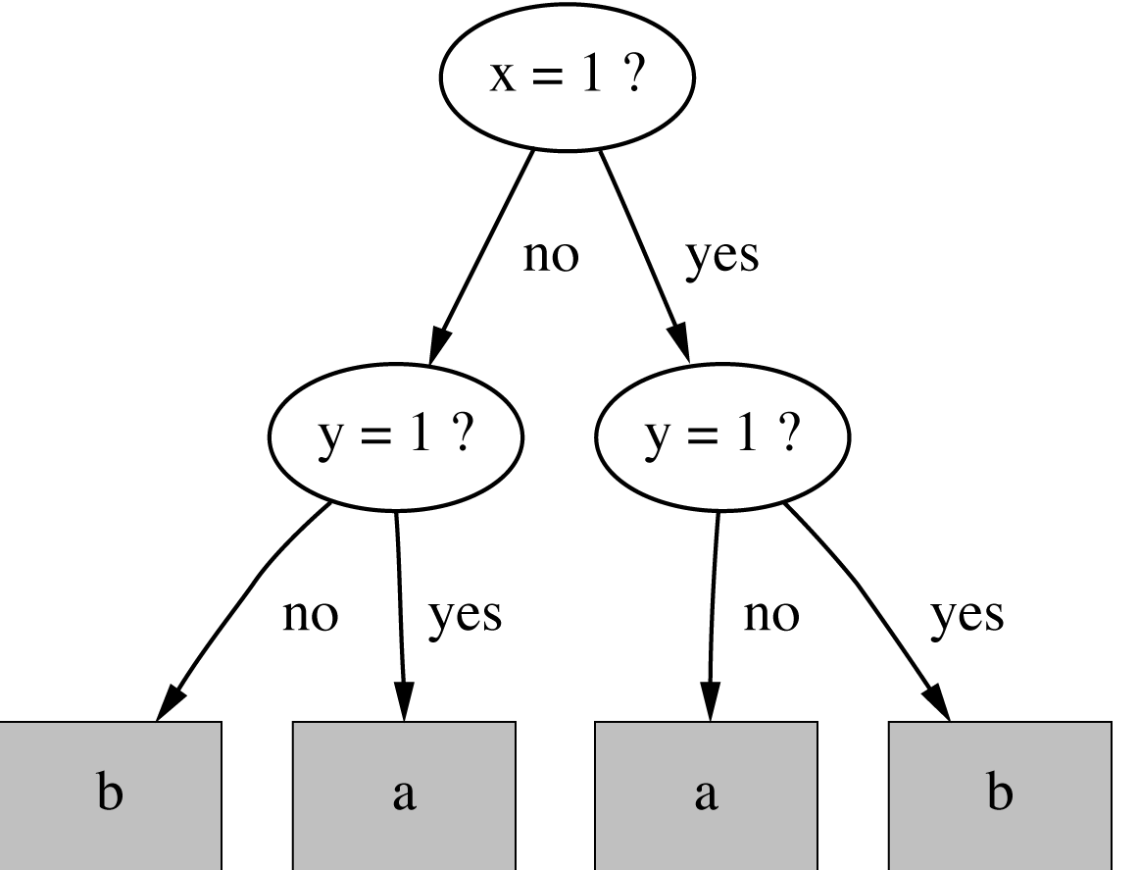
The exclusive-or problem
If x = 1 and y = 0 then class = a If x = 0 and y = 1 then class = a If x = 0 and y = 0 then class = b If x = 1 and y = 1 then class = b
Notes:
Although the tree is not noticeably more or less compact than the rules, modulo the classes in the leaves it has a replicated subtree.

Slide 13
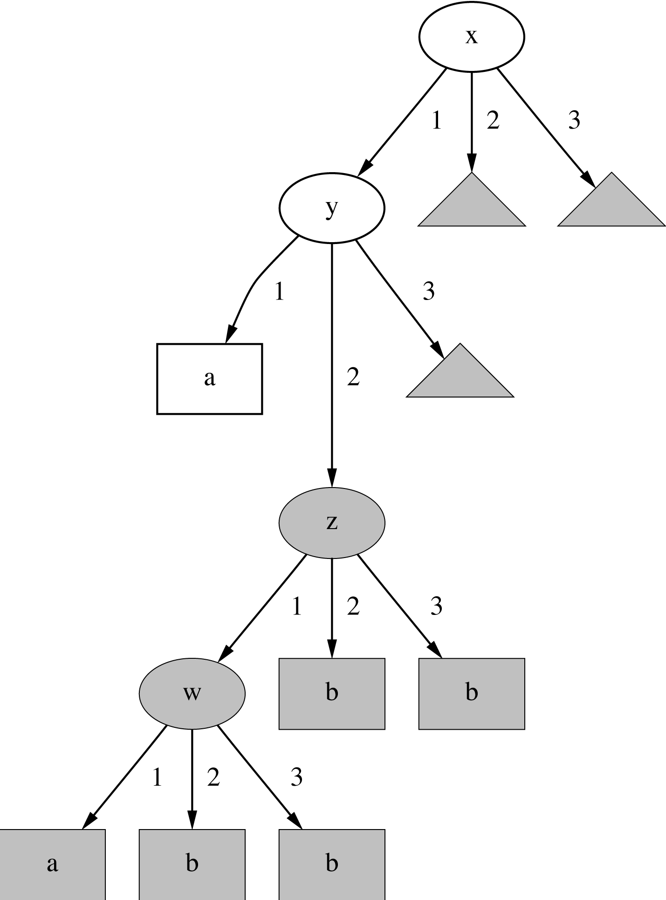
A tree with a replicated subtree
If x = 1 and y = 1 then class = a If z = 1 and w = 1 then class = a Otherwise class = b
Notes:
In this example, where three variables x, y and z can take on the values 1, 2 or 3, the tree representation is significantly more complex – each triangle represents a complete replication of the subtree rooted at z.

Slide 14
“Nuggets” of knowledge
Are rules independent pieces of knowledge? (It seems easy to add a rule to an existing rule base)
Problem: ignores how rules are executed
Two ways of executing a rule set:
Ordered set of rules (“decision list”)
Order is important for interpretation (see example in notes)
Unordered set of rules
Rules may overlap and lead to different conclusions for the same instance (see example in notes for attributes x and y)
Notes:
Consider the following code:
if (x) then result=true;
if (y) then result=false;
Is this code correct when both x and y are true? What if we switch the order of the if() statements? How could we guarantee one form of correctness?
if (x) then result=true;
else if (y) then result=false;
But now we are no longer logically ORing the rules together – the two rules in the if-else statement are no longer independent.
Question for deeper thought: would other ways of combining rules work better? E.g., instead of logically ORing rules together, what if we ANDed them together? Or used an XOR operator?

Slide 15
Interpreting rules
What if two or more rules conflict?
Give no conclusion at all?
Go with rule that is most popular on training data?
…
What if no rule applies to a test instance?
Give no conclusion at all?
Go with class that is most frequent in training data?
…
Notes:
Under normal circumstances, these things do not happen in a decision tree.

Slide 16
Special case: Boolean class
Assumption: if instance does not belong to class “yes”, it belongs to class “no”
Trick: only learn rules for class “yes” and use default rule for “no”
Order of rules is not important. No conflicts because there are only two classes!
Rule can be written in disjunctive normal form
Caveat: Only applies to two-class problems!
If x = 1 and y = 1 then class = a If z = 1 and w = 1 then class = a Otherwise class = b
Notes:
Basically, the two if() statements above are ORed together naturally during program execution.
What about our LinkedIn recruiter example; rules for deciding to reach out to a potential candidate or not?

Slide 17
Association rules
Association rules…
… can predict any attribute and combinations of attributes
… unlike classification rules, are not intended to be used together as a set
Problem: immense number of possible associations
Output needs to be restricted to show only the most predictive associations ⇒ only those with high support and high confidence
Notes:
With our running LinkedIn example, what combinations of attributes might we be interested in predicting?

Slide 18
Support and confidence of a rule
Support (coverage): number (or percentage of total) of instances predicted correctly
Confidence (accuracy): number of correct predictions, as proportion of all instances that rule applies to
Example: 4 cool days with normal humidity
Support = 4, confidence = 100%
Normally, minimum support and confidence are pre-specified
E.g., with support ≥ 2 (or 2/14 = 1/7) and confidence = 100%, 58 rules are generated for the weather data
If temperature = cool then humidity = normal
Notes:
Support or coverage can also be measured as a ratio of the number of instances predicted correctly and the total number of instances. This corresponds roughly to recall in information retrieval. Note also that confidence or accuracy, as measured herein, corresponds to precision in information retrieval.

Slide 19
Metrics for Evaluation
The confusion matrix for a two-class problem:
 |  | Predicted class
 |  | Yes | No
Actual class | Yes | True positive | False negative
 | No | False positive | True negative
Notes:
This can be found in Weka; e.g. looking at the breast cancer data and decision stump.

Slide 20
Metrics in Data Mining (and IR)
TP Rate: TP/(TP+FN)
FP Rate: FP/(FP+TN)
Precision: TP/(TP+FP)
In IR, percentage of retrieved documents that are relevant
Recall: =TP/(TP+FN)
In IR, percentage of relevant documents that are returned
Precision/recall are in general inversely related
F-measure: (2×recall×precision)/(recall+precision)
These five metrics are all reported in WEKA
Notes:
Again, these can be shown in weka.

Slide 21
Interpreting association rules
Interpretation is not obvious:
does imply
but do these two rules imply the one above?
The first rule also implies the following:
Which rule(s) is(are) best?
If windy = false and play = no then outlook = sunny and humidity = high
If windy = false and play = no then outlook = sunny If windy = false and play = no then humidity = high
If humidity = high and windy = false and play = no then outlook = sunny
Notes:
The two rules do not necessarily imply the first. E.g., if we take the following instances:
sunny,hot,normal,FALSE,no
overcast,hot,high,FALSE,no
Then these two instances do imply the two rules, but cannot be combined to imply the first.
In terms of figuring out which rule(s) is(are) best, think about the last rule above – what is the support/accuracy compared to the first rule? Suppose we add the instance:
sunny,hot,normal,FALSE,no
Then the support for the last rule remains two, and confidence remains 100%, and although support for the first rule also remains two, confidence drops to ~67% because the “windy = false and play = no” antecedent in the first rule matches the new instance, but the “outlook = sunny and humidity = high” consequent in the first rule does not.
If we look at the association rules in the slide (rules 1-3), how would we represent these rules in a Venn diagram? (Do in small groups in class.)

Slide 22
Rules with exceptions
Idea: allow rules to have exceptions
Example: rule for iris data
New instance:
Modified rule:
If petal-length ≥ 2.45 and petal-length < 4.45 then Iris-versicolor
Sepal length | Sepal width | Petal length | Petal width | Type
5.1 | 3.5 | 2.6 | 0.2 | Iris-setosa
If petal-length ≥ 2.45 and petal-length < 4.45 then Iris-versicolor EXCEPT if petal-width < 1.0 then Iris-setosa
Notes:
Can you write this modified rule using if-then-else syntax (i.e., without the EXCEPT clause)?
if p-l g.e. 2.45
if p-l l.t. 4.45
if p-w l.t. 1.0
i-s
else
i-v
What about our LinkedIn example… what are some exceptions we might want?

Slide 23
Advantages of using exceptions
Rules can be updated incrementally
Easy to incorporate new data
Easy to incorporate domain knowledge
People often think in terms of exceptions
Each conclusion can be considered just in the context of rules and exceptions that lead to it
Locality property is important for understanding large rule sets
“Normal” rule sets don’t offer this advantage

Slide 24
A more complex example
Exceptions to exceptions to exceptions …
default: Iris-setosa except if petal-length ≥ 2.45 and petal-length < 5.355 and petal-width < 1.75 then Iris-versicolor except if petal-length ≥ 4.95 and petal-width < 1.55 then Iris-virginica else if sepal-length < 4.95 and sepal-width ≥ 2.45 then Iris-virginica else if petal-length ≥ 3.35 then Iris-virginica except if petal-length < 4.85 and sepal-length < 5.95 then Iris-versicolor
Notes:
The logical structure of “default – except if – then” constructs is identical to “if – then – else” constructs. The ‘default’ is simply an unconditional else.

Slide 25
More on exceptions
Default...except if...then...
is logically equivalent to
if...then...else
(where an unconditional else specifies the default)
But: exceptions offer a psychological advantage
Assumption: defaults and tests early on apply more widely than exceptions further down
Exceptions reflect special cases

Slide 26
Rules involving relations
So far: all rules involved comparing an attribute-value to a constant (e.g., temperature < 45)
These rules are called “propositional” because they have the same expressive power as propositional logic
What if problem involves relationships between examples (e.g., the family tree from Lecture 1)?
Can’t be expressed with propositional rules
More expressive representation required

Slide 27
The shapes problem
Target concept: standing up
Shaded: standing Unshaded: lying

Slide 28
A propositional solution
Width | Height | Sides | Class
2 | 4 | 4 | Standing
3 | 6 | 4 | Standing
4 | 3 | 4 | Lying
7 | 8 | 3 | Standing
7 | 6 | 3 | Lying
2 | 9 | 4 | Standing
9 | 1 | 4 | Lying
10 | 2 | 3 | Lying
If width ≥ 3.5 and height < 7.0 then lying If height ≥ 3.5 then standing

Slide 29
A relational solution
Comparing attributes with each other
Generalizes better to new data
Standard relations: =, <, >
But: learning relational rules is costly
Simple solution: adding extra attributes (e.g., a binary attribute is width < height?)
If width > height then lying If height > width then standing

Slide 30
Rules with variables
Using variables and multiple relations:
The top X of a tower of blocks Y is standing:
The whole tower Y is standing:
Recursive definition!
If height_and_width_of(x,h,w) and h > w then standing(x)
If height_and_width_of(x,h,w) and h > w and is_top_of(x,y) then standing(x)
If height_and_width_of(z,h,w) and h > w and is_top_of(z,y) and is_rest_of(y,x) and standing(x) then standing(y) If empty(y) then standing(y)

Slide 31
Inductive logic programming
Recursive definition can be seen as logic program
Techniques for learning logic programs stem from the area of “inductive logic programming (ILP)”
But: recursive definitions are extremely hard to learn in practice
Also: very few practical problems require recursion
Thus: many ILP techniques are restricted to non-recursive definitions to make learning easier

Slide 32
Trees for numeric prediction
Regression: the process of computing an expression that predicts a numeric quantity
Regression tree: “decision tree” where each leaf predicts a numeric quantity
Predicted value is average value of training instances that reach the leaf
Model tree: “regression tree” with linear regression models at the leaf nodes
Linear patches approximate continuous function

Slide 33
Linear regression for the CPU data
PRP =
- 56.1
+ 0.049 MYCT
+ 0.015 MMIN
+ 0.006 MMAX
+ 0.630 CACH
- 0.270 CHMIN
+ 1.46 CHMAX

Slide 34
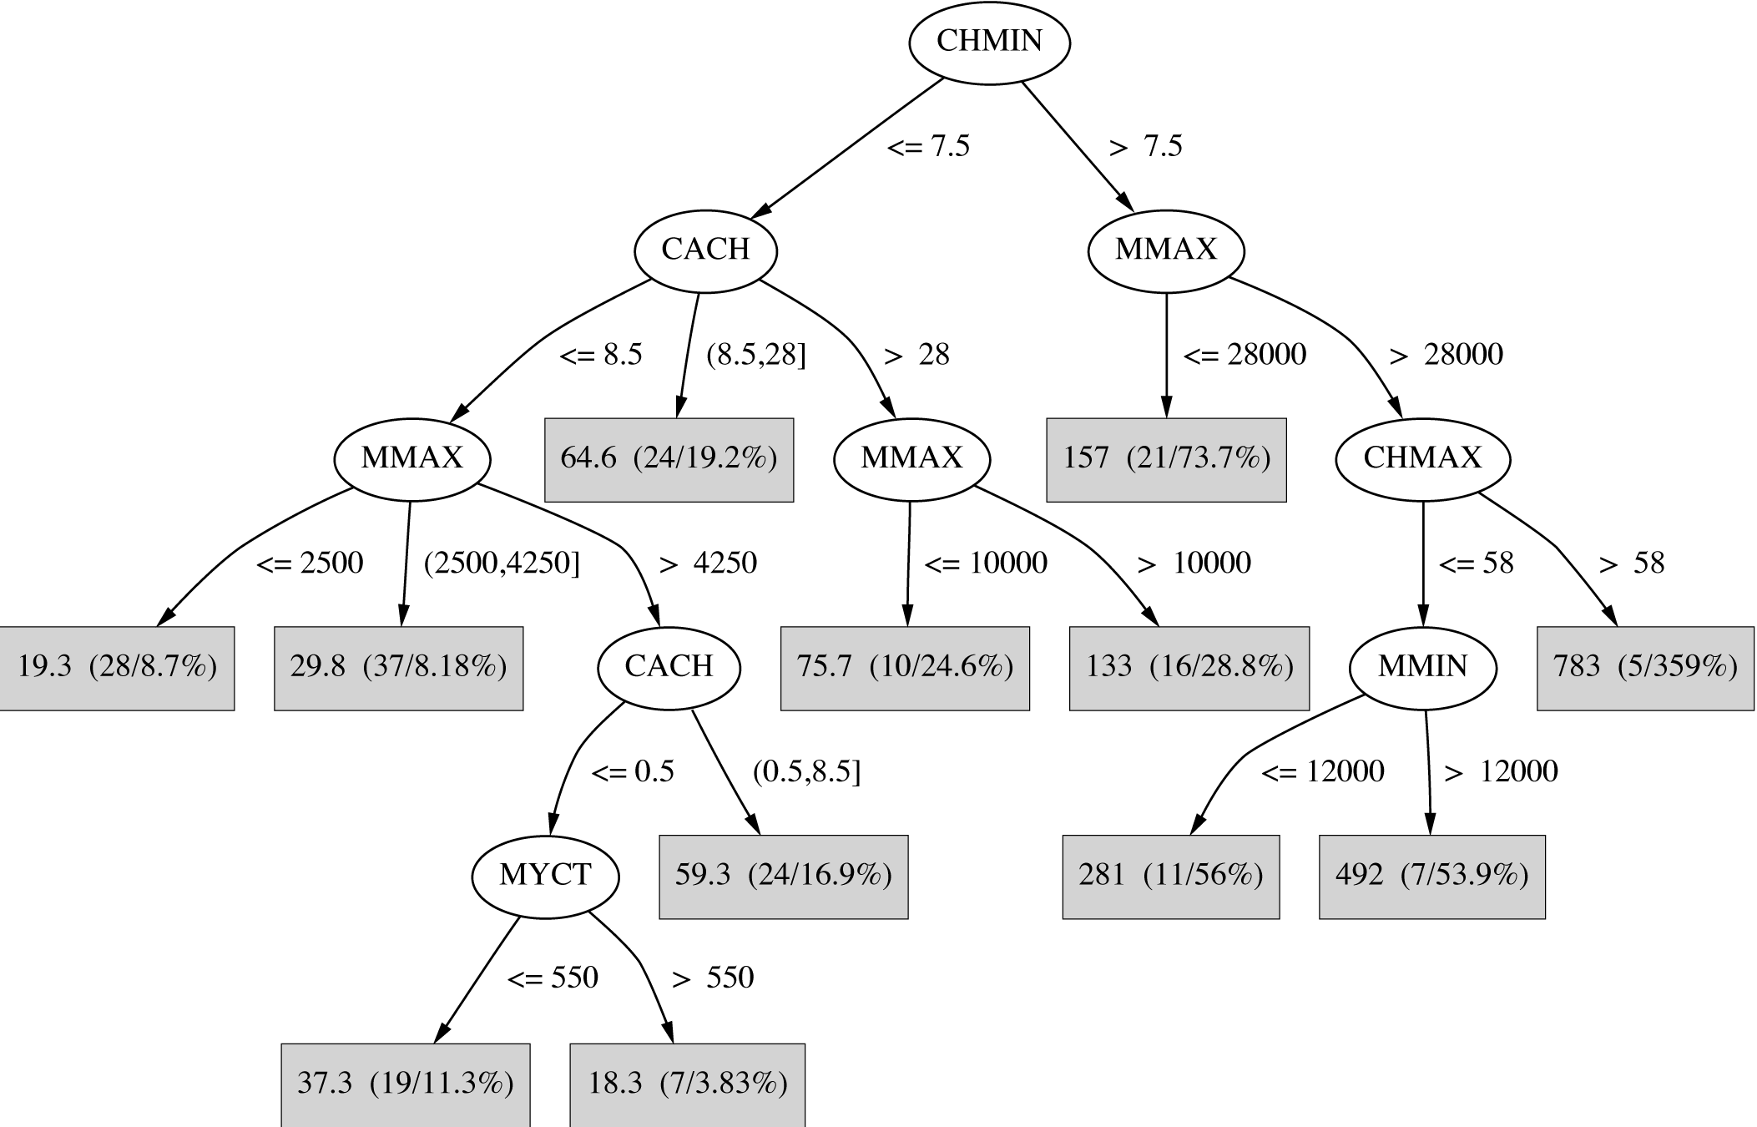
Regression tree for the CPU data
Notes:
The parenthesized measures at each linear model (leaf node) are the support, # instances, and either variance or standard deviation.
The data is from 3rd Edition, page 16

Slide 35
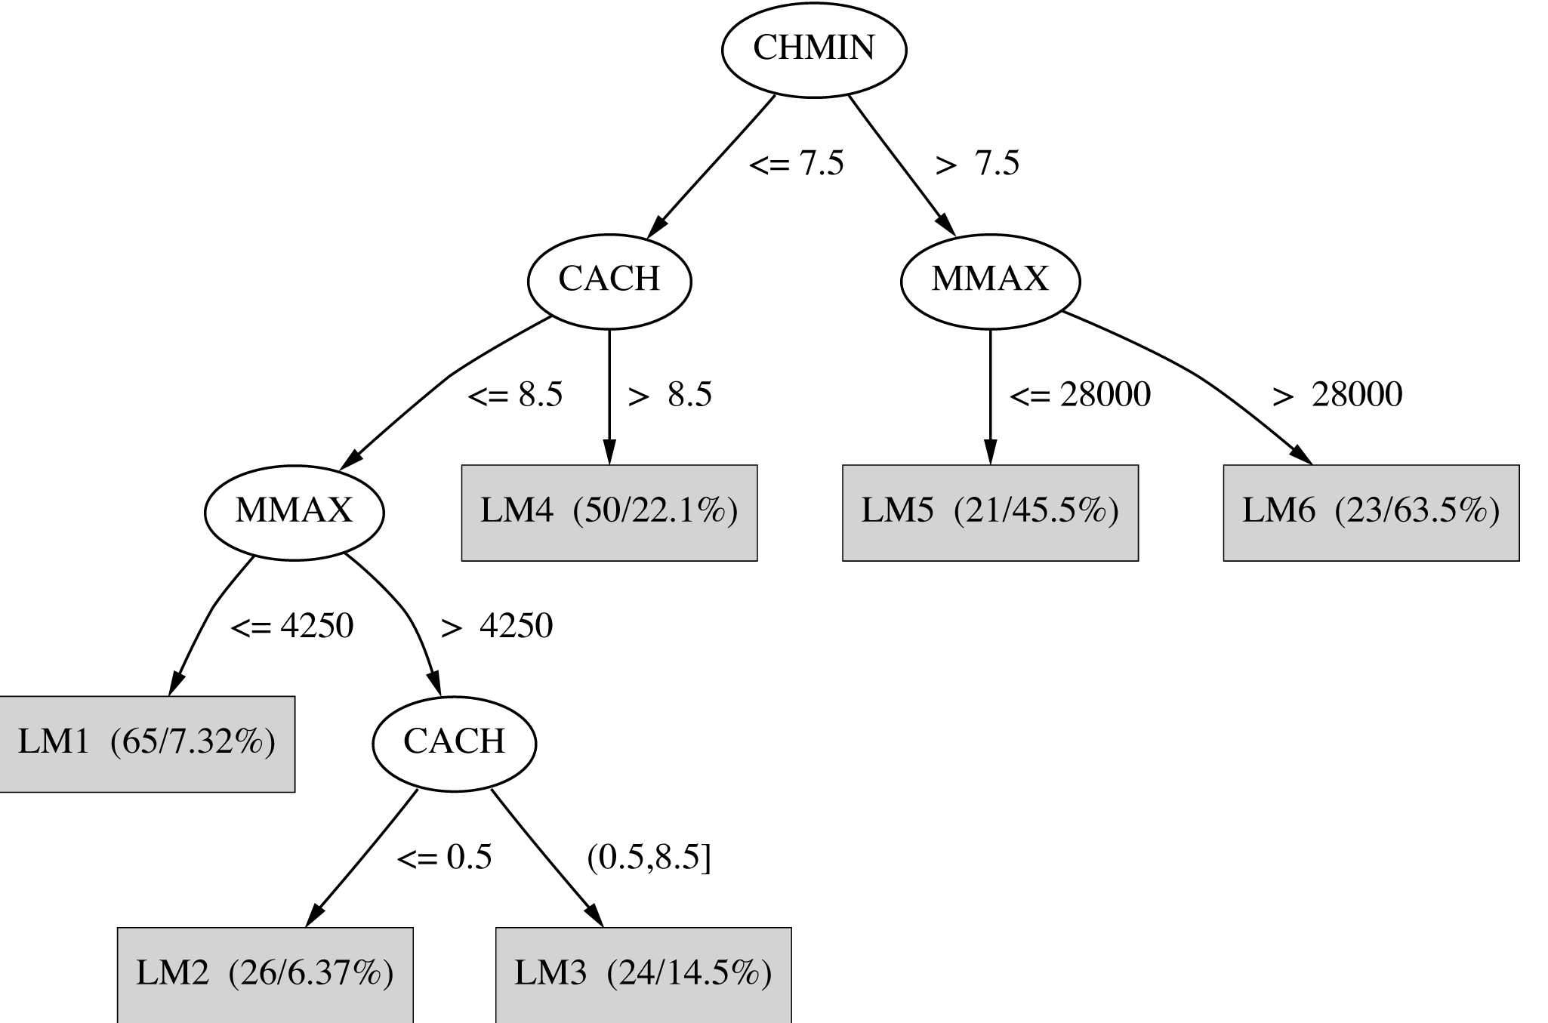
Model tree for the CPU data

Slide 36
Instance-based representation
Simplest form of learning: rote learning
Training instances are searched for instance that most closely resembles new instance
The instances themselves represent the knowledge
Also called instance-based learning
Similarity function defines what’s “learned”
Instance-based learning is lazy learning
Methods: nearest-neighbor, k-nearest-neighbor, …
Notes:
Instance-based learning is lazy (whereas other techniques are eager) because the class of a given instance is not limited to a pre-computed model; rather, a new instance is classified based on its distance to existing instances. In this sense, no explicit class boundaries are created during learning – rather, the instances in the training set are just ‘put out there’ as is.

Slide 37
The distance function
Simplest case: one numeric attribute
Distance is the difference between the two attribute values involved (or a function thereof)
Several numeric attributes: normally, Euclidean distance is used and attributes are normalized
Nominal attributes: distance is set to 1 if values are different, 0 if they are equal
Are all attributes equally important?
Weighting the attributes might be necessary
Notes:
“Deriving suitable attribute weights from the training set is a key problem in instance-based learning.” Witten & Frank text page 78.

Slide 38
Learning prototypes
Only those instances involved in a decision need to be stored
Noisy instances should be filtered out
Idea: only use prototypical examples

Slide 39
Rectangular generalizations
Nearest-neighbor rule is used outside rectangles
Rectangles are rules! (But they can be more conservative than “normal” rules.)
Nested rectangles are rules with exceptions

Slide 40
Representing clusters I
Simple 2-D representation
Venn diagram
Overlapping clusters
Notes:
Think about attributes that might give clues to terrorist activity…
What is an example of what you'd use a Venn diagram for? What about the tennis grand slam? We could look at tennis player participants in the US Open, Wimbledon, Australian Open, and the French Open, and see the overlap of contestants at all 4 venues, at 2 specific venues, etc.

Slide 41
Representing clusters II
Probabilistic assignment
Dendrogram
1 2 3
a 0.4 0.1 0.5
b 0.1 0.8 0.1
c 0.3 0.3 0.4
d 0.1 0.1 0.8
e 0.4 0.2 0.4
f 0.1 0.4 0.5
g 0.7 0.2 0.1
h 0.5 0.4 0.1
…
Note: dendron is the Greek word for tree

Slide 43
Weka
Download Weka
We can remove instances within Weka
Let’s try this with the Iris dataset
We can also remove entire attributes within Weka
Let’s also try this with the Iris dataset

Slide 44
Weka
Now what about if we want to add instances?
Let’s try this with Wordpad (note: not MS Word)
Now, how to get back into arff format?

Slide 45
Weka
“You need to make the file extensions visible and editable, which it probably will not be by default. The exact method depends on the version of Windows. In my current version I go to the Windows explorer window and then select the "tools" menu option, then "Folder Options", then "view", and then deselect the checkbox for "hide extensions for known file types." When you do not hide the extensions, you can edit them easily and thus change them from .txt to .arff and back again.”
http://storm.cis.fordham.edu/~gweiss/data-mining/weka.html

Slide 46
Weka
We can also use Weka with CSV files (which you will probably do with your class projects)
How to save a file as CSV? Typically in MS Excel, save as CSV
Then within Weka, must choose to show all files or show CSV files in order to select it to view
How can we see our class distribution?
Let’s look at the Iris dataset, and choose to visualize the class

Slide 47
Weka
Now what if we want to actually classify something?
Let’s look at OneR
We can choose 10 fold cross validation
We can also look at a percentage split
What about if I want to experiment and run this more than one time?
More options -> Random Seed Value

Slide 48
Weka
What if I want to know what OneR is?
Select it to classify your data. Then click on OneR, then click on More, and a synopsis comes up with more information
Now let’s run the model: click Start
Now we can see the confusion matrix, along with some performance metrics
Accuracy, TP, FP, Precision, Recall, F-Measure

